Slide 1

The Security Guide to the Internet
Author: Bc. David Nápravník
Supervisor: doc. Mgr. Cyril Brom, Ph.D.
Let’s play and learn
2025
Image from deep.ai

Slide 2
Motivation
95%
26%
The growing threat landscape for children online
Need for engaging cybersecurity education
kids are using mobile phone with internet access daily in age of 12 in Czech Republic
of children (11-15 y.o.) report
encountering phishing attack
Source: eu_kids_online_report
Source: Overconfident and over exposed

Slide 3
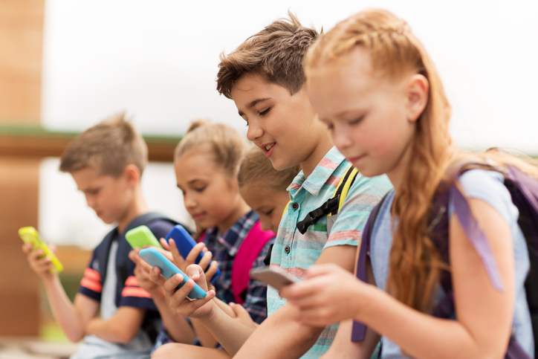
Target Audience
Middle school students.
Single player at home, or at school.
Czech or English speaking.
Years 11-15
Kids doesn’t have much security awareness and they are often exposed to cyber danger
Image from freedomfone.org

Slide 4

Security thread topics
Malware: Virus, Antivirus, Firewall, Software updates, Data backup
File extensions, Game with virus, Fake free stuff
Antivirus is a good thing, but it doesn't do everything
Privacy: Phishing, Identity theft, Social engineering
Digital footprint, Privacy protection, Bad practices
Cookies & GDPR
Phone: App Permissions
Bluetooth and wi-fi safe usage
Access: Strong passwords, Password managers, Two-factor Authentication
AI: Information quality, private data sharing
Image from deep.ai

Slide 5

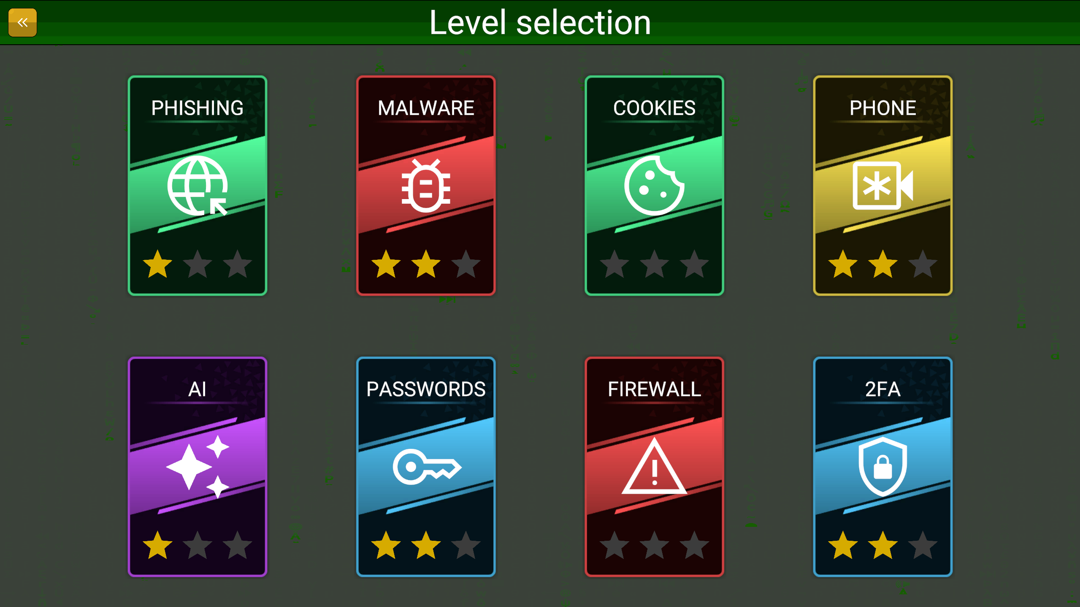
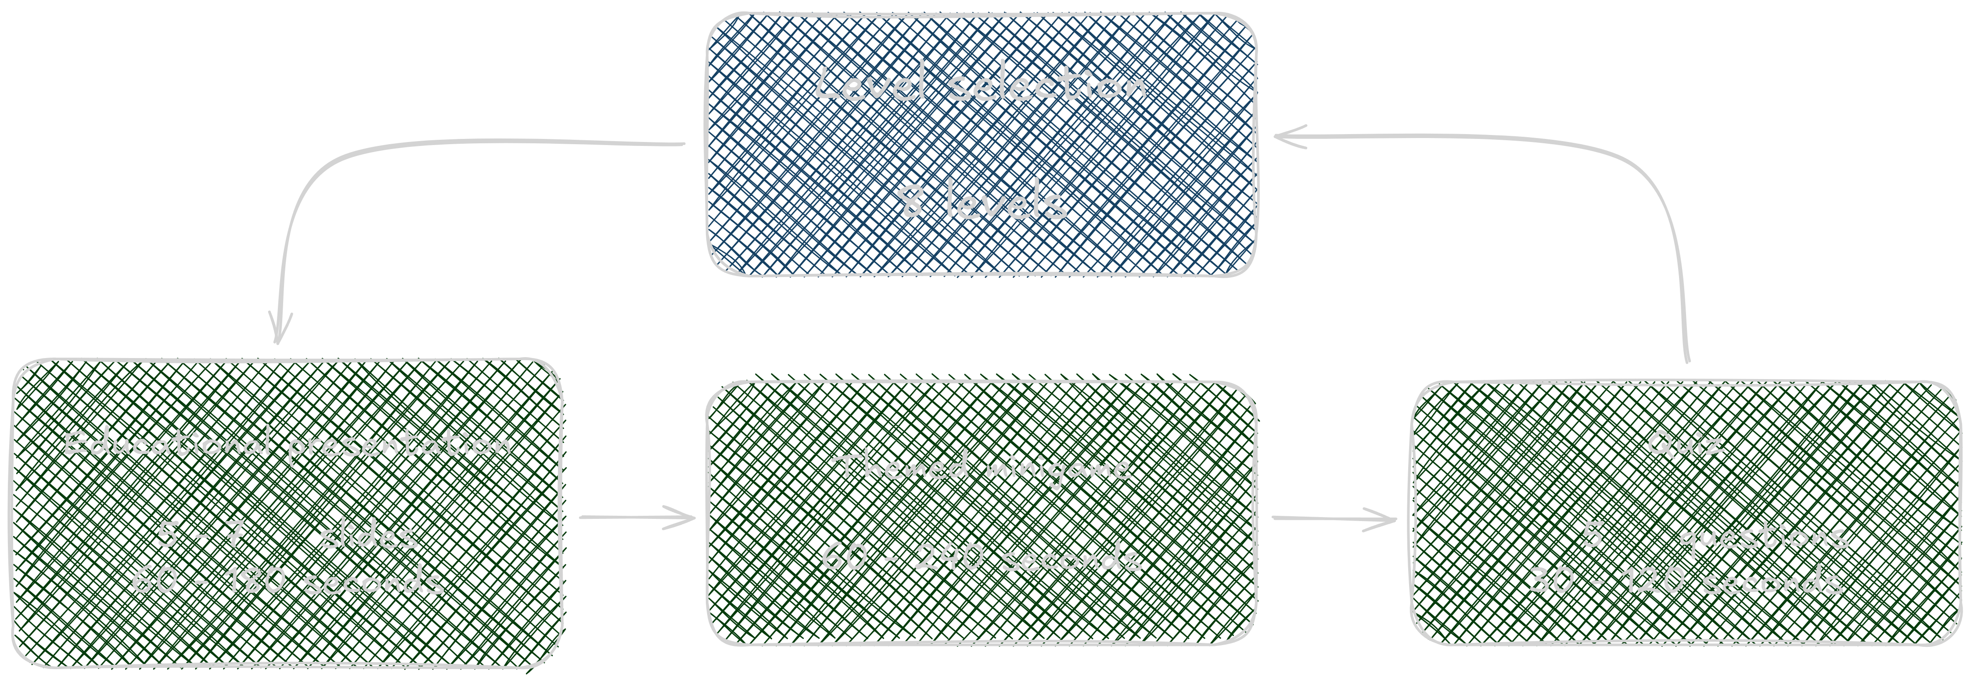
8 levels
Each for some group of security topic
Each have presentation, minigame and quiz
Multiple devices support
Android, Computer (without installation)
Compliances
PEGI 7 (no inappropriate content)
Game Concept
Images from the thesis

Slide 6
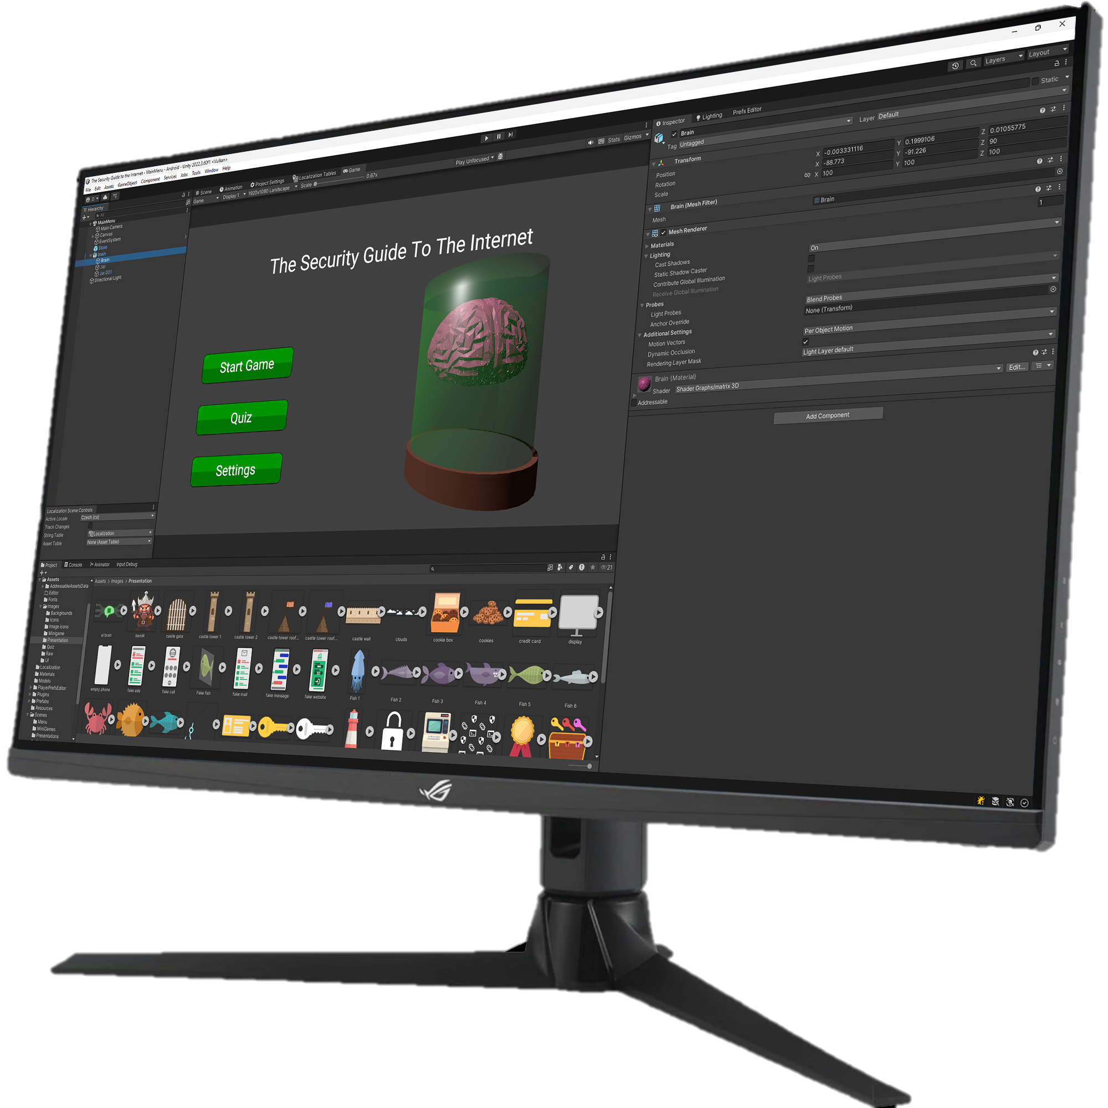


Implementation Details
Game engine
Localization
Text rendering optimizations
Bundle size optimizations
Level-specific mechanic
 | Godot | Unity | Unreal engine
Web build
Low-end devices
Advanced profiling tools
Image of this thesis Unity project

Slide 7


Implementation Details
Unity engine
Localization
Text rendering optimizations
Bundle size optimizations
Level-specific mechanic
1 bod
Získal jsi
2 body
5 bodů
Possible to easily add more languages
1 point
You got
2 points
Image from the thesis

Slide 8



Implementation Details
Unity engine
Localization
Text rendering optimizations
Bundle size optimizations
Level-specific mechanic
Raster
SDFAA
WCAG 2.0
Contrast ≥ 4.5
Text size ≥ 24 px
AA
SDF32
Images from the thesis

Slide 9
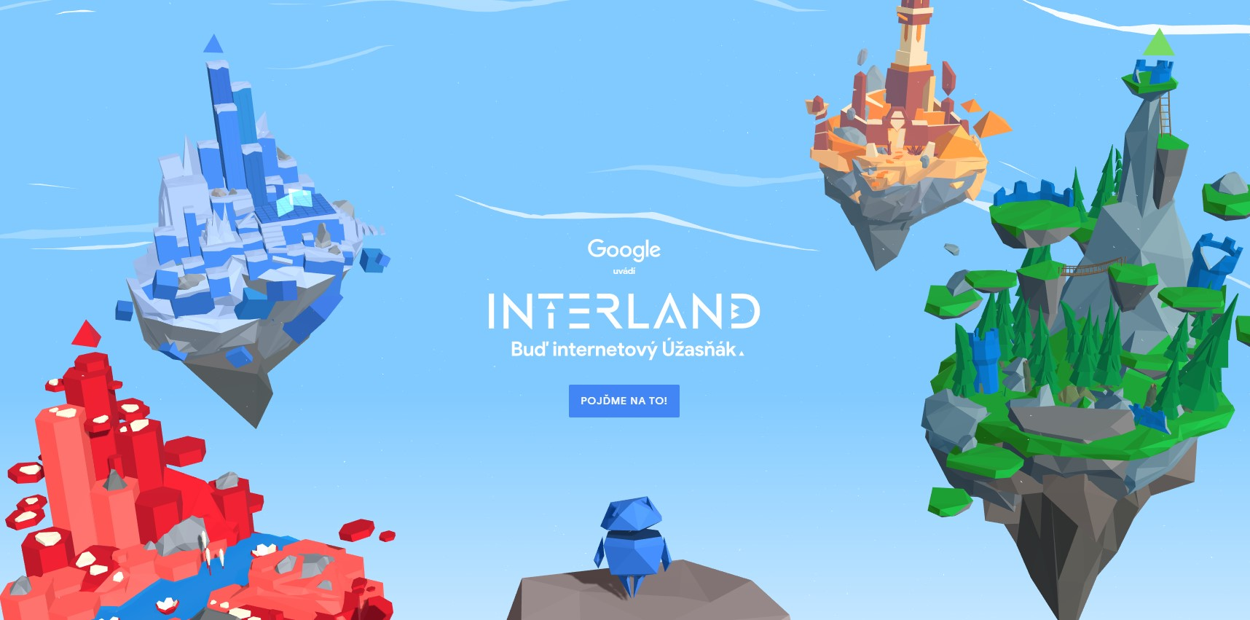

Implementation Details
Unity engine
Localization
Text rendering optimizations
Bundle size optimizations
Level-specific mechanic
Scripts 2%
Shaders 4%
Models 3%
Other 9%
Textures 82%
28.8 MB (4 levels)
Pre-rendered Font atlas 9%
11.2 MB (8 levels)
78.1 MB (2 levels)
Images from beinternetawesome.withgoogle.com & internethighway.e-bezpeci.cz

Slide 10
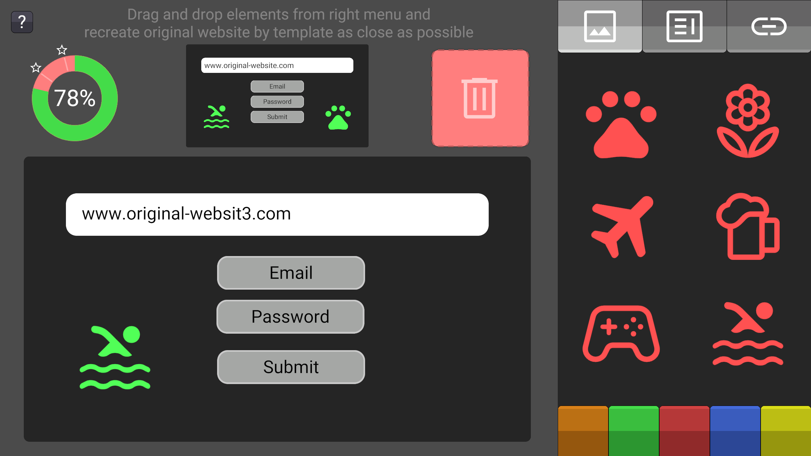
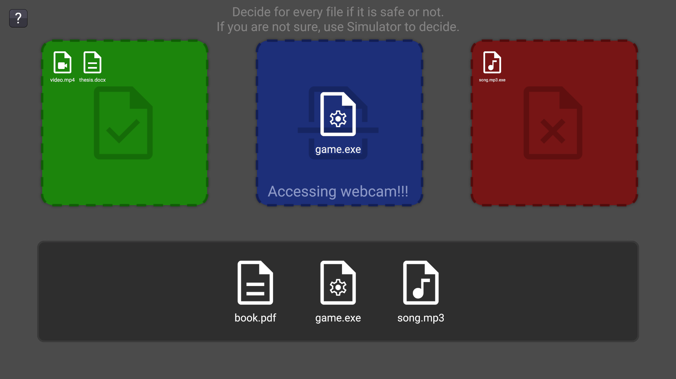
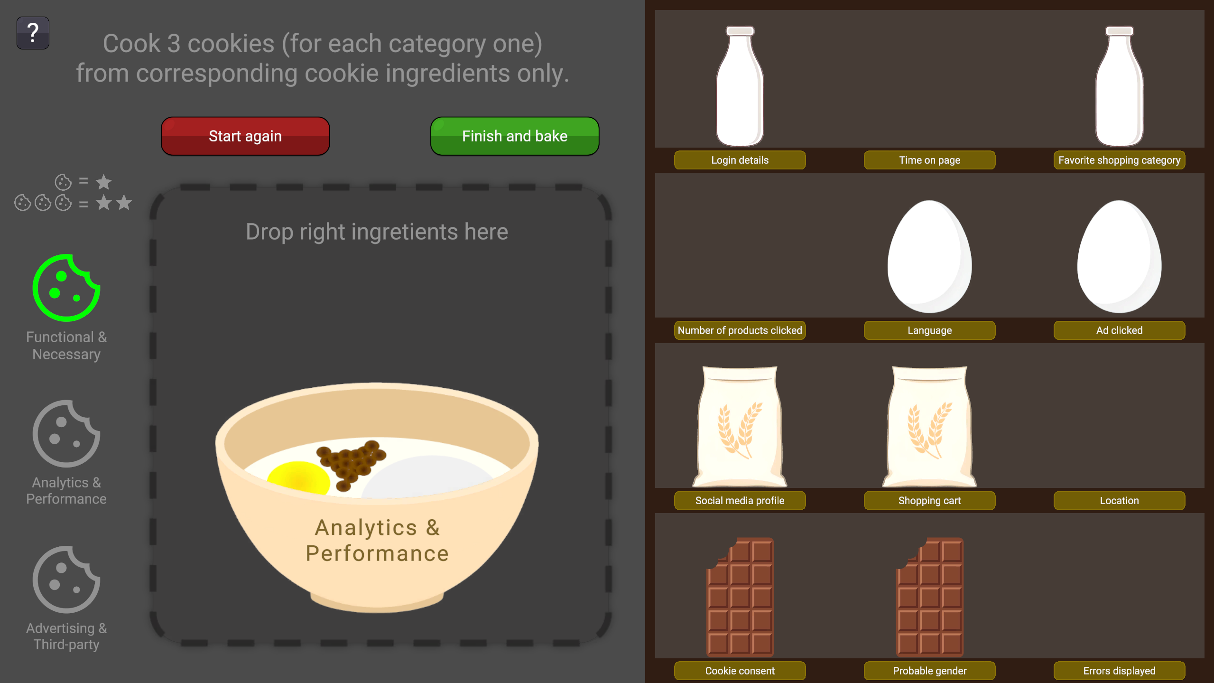
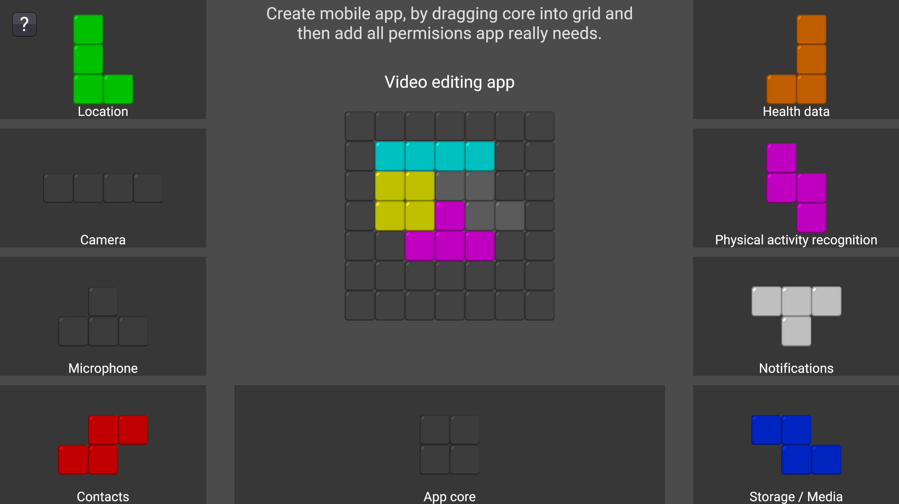
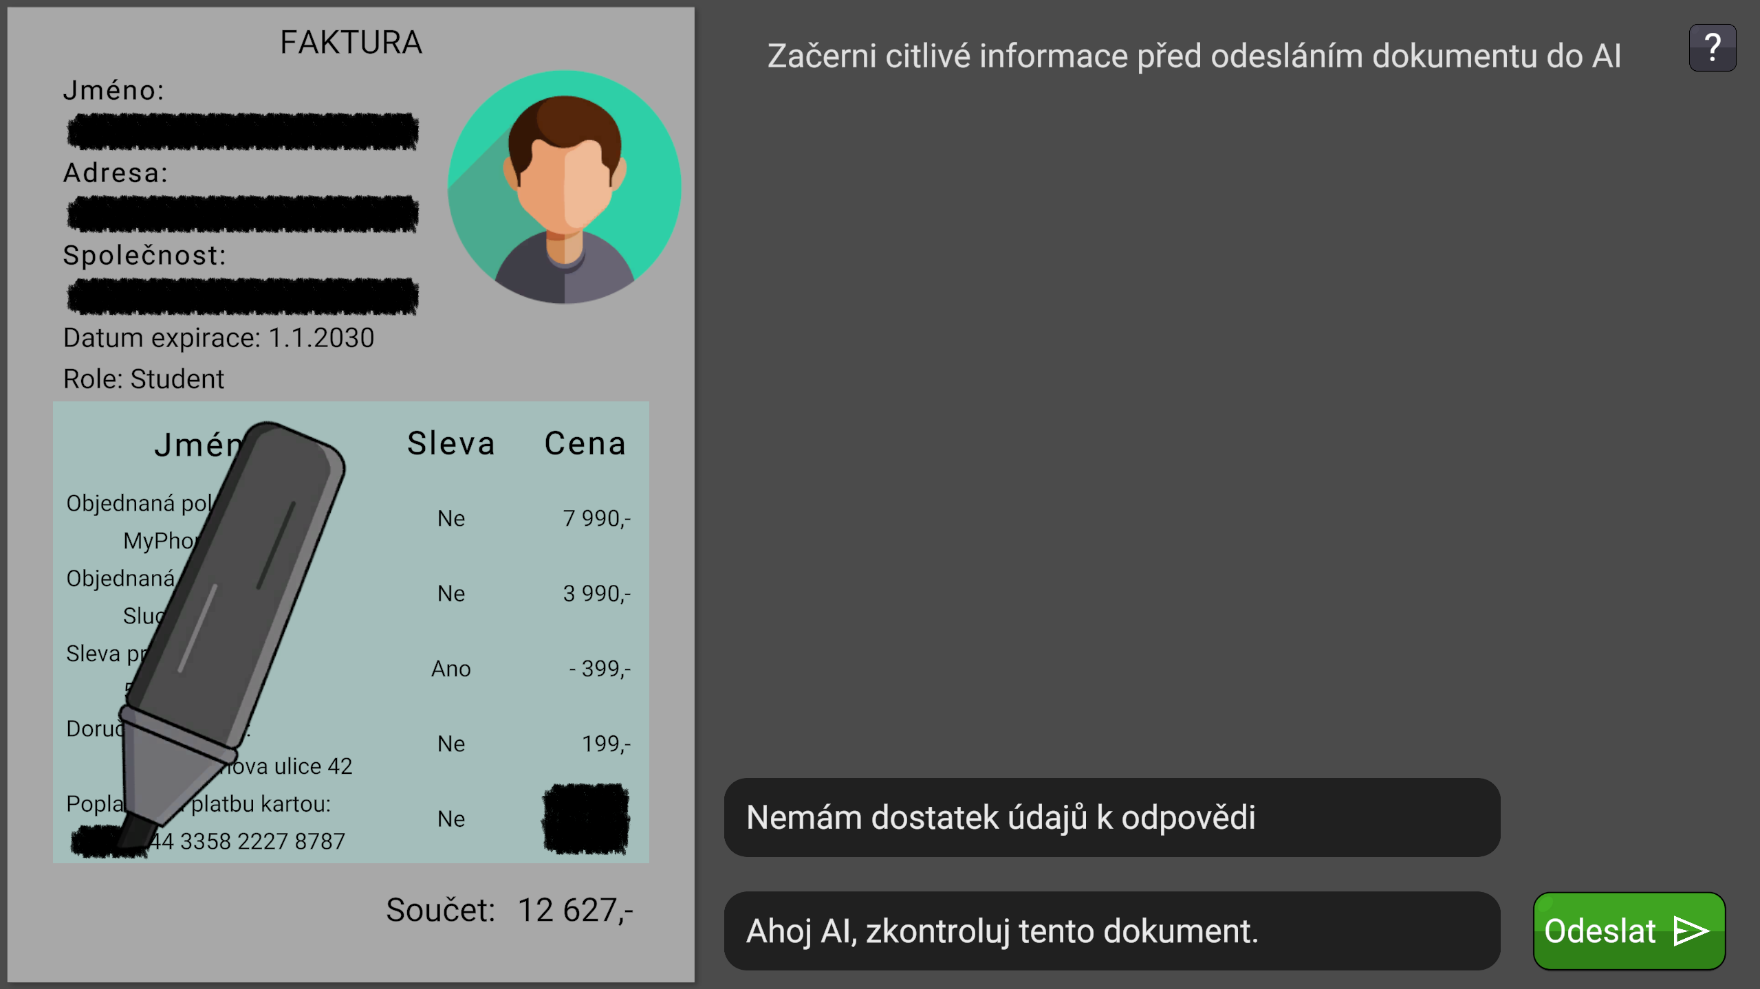
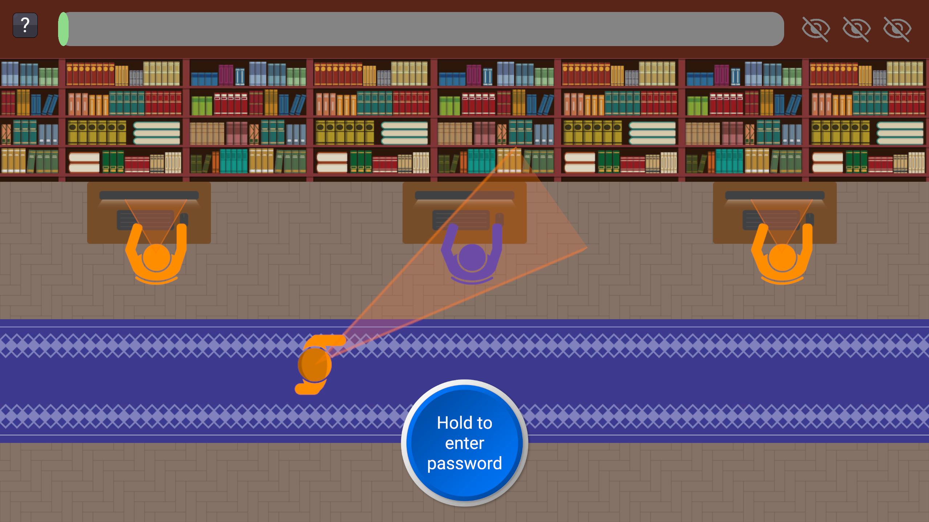

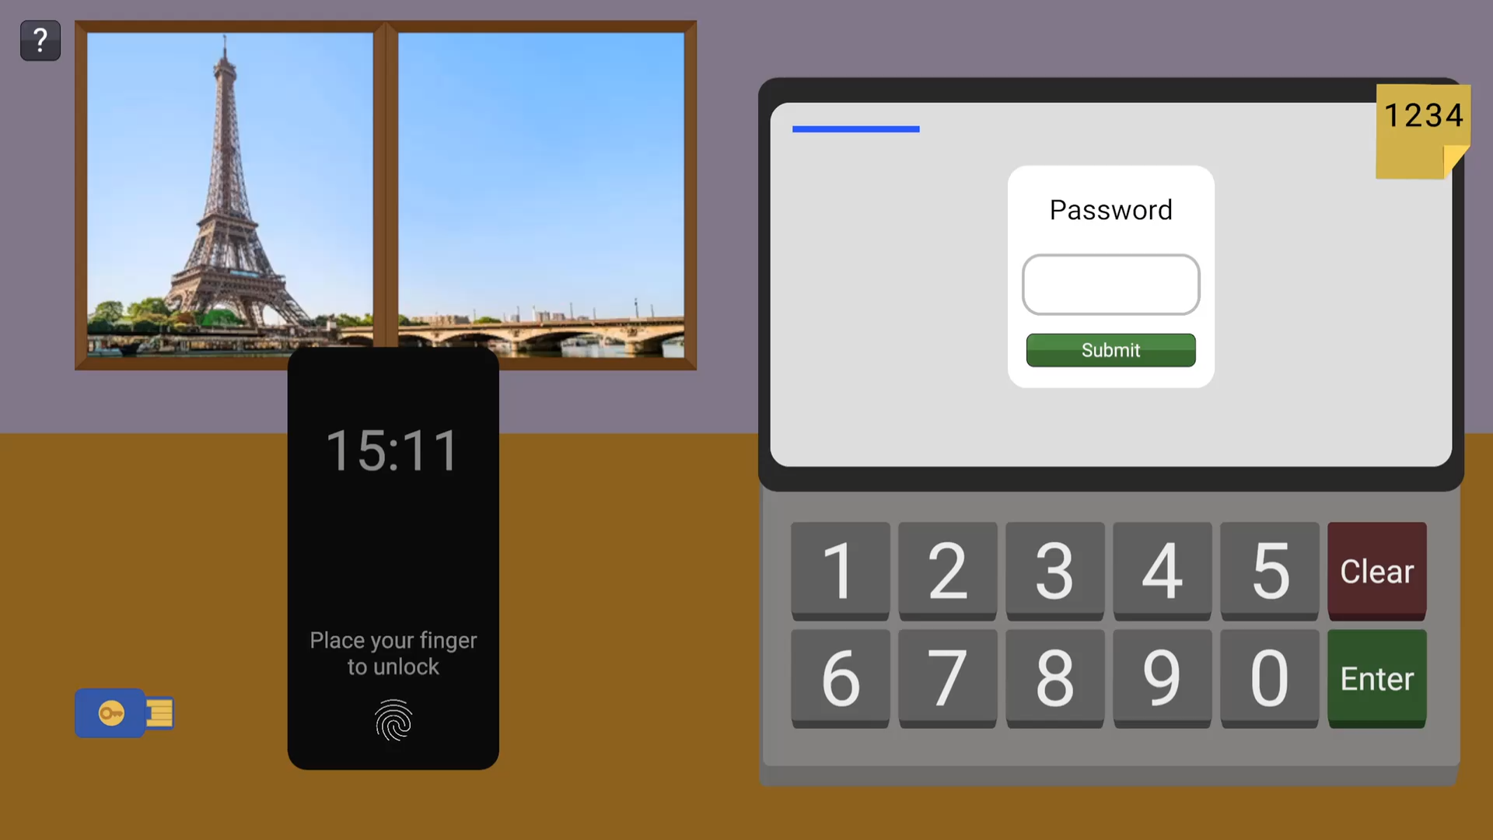
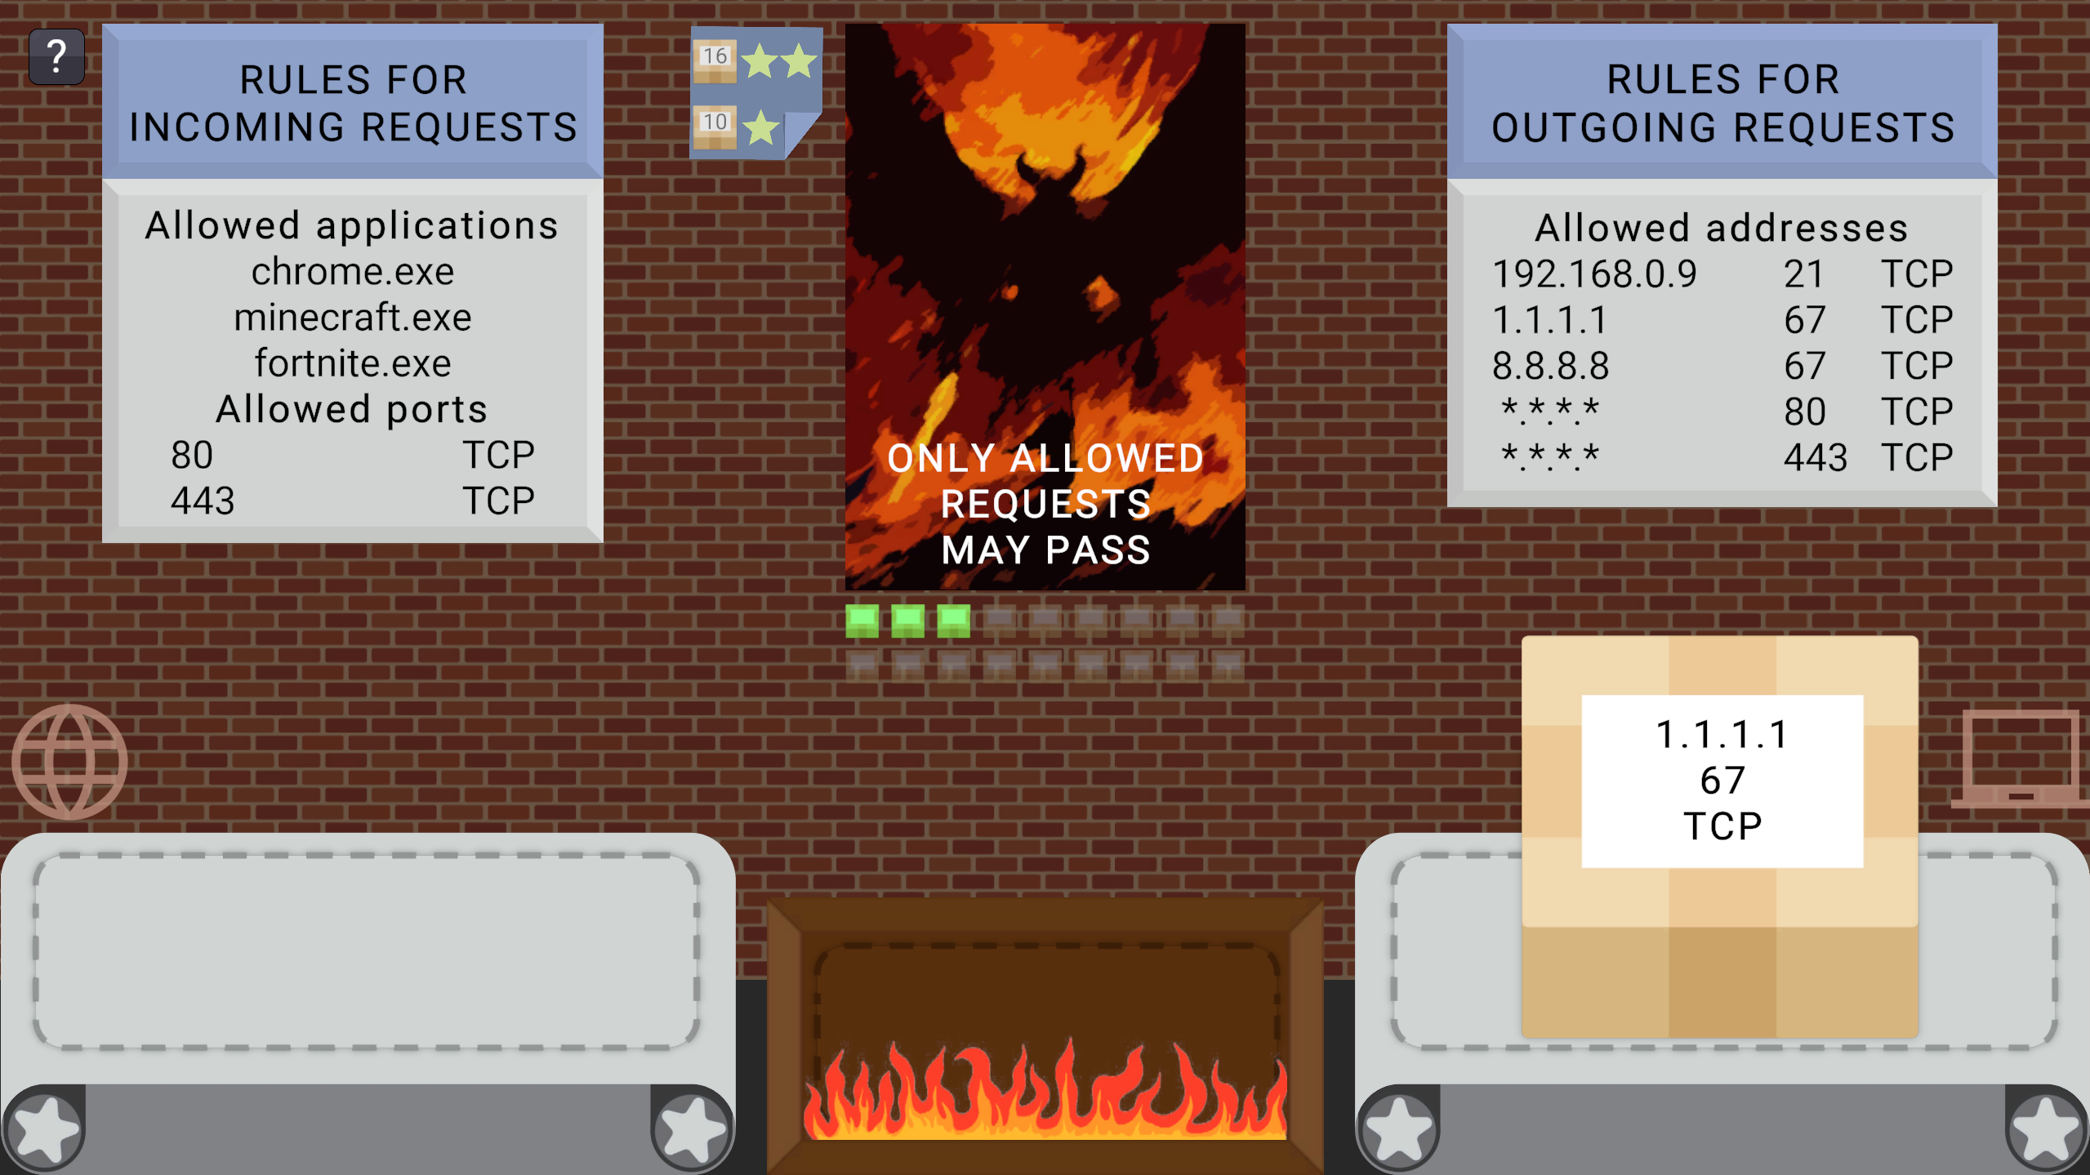
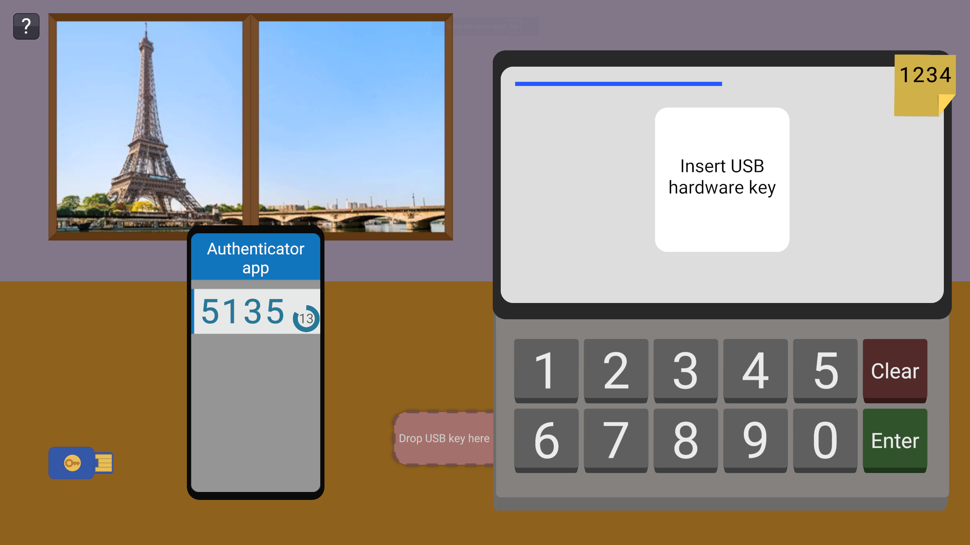
Implementation Details
Unity engine
Localization
Text rendering optimizations
Bundle size optimizations
Level-specific mechanic
Images from the thesis

Slide 11



Testing & Results
Testing methodology
Data collection
Findings
Individual testing
Class testing 1
28 kids
Class testing 2
25 kids
Testing for Google
24 people

Slide 12
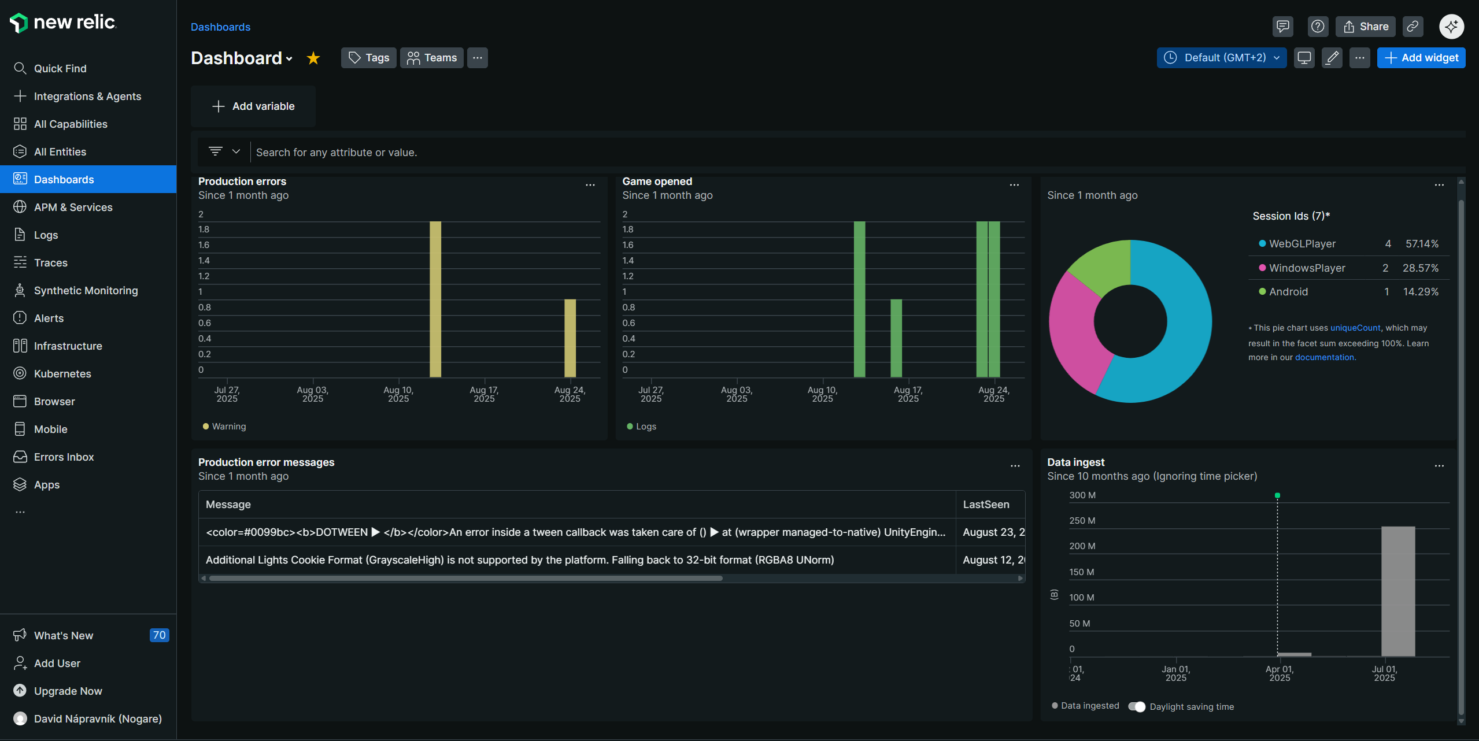
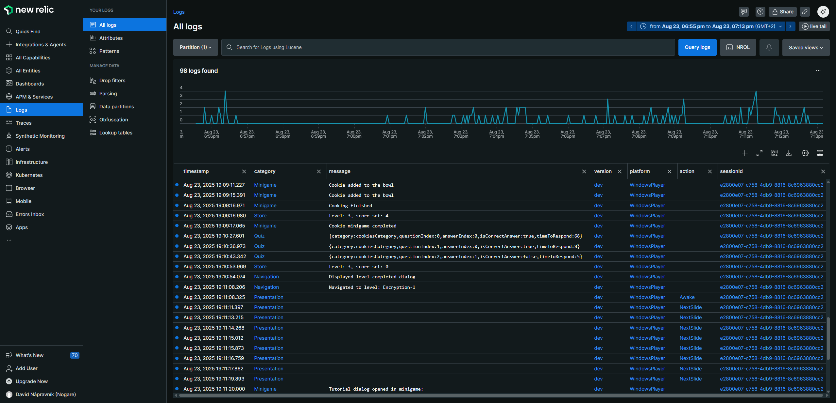
Testing & Results
Testing methodology
Data collection
Findings
18 000 Logs in total
Device
Navigation
What user clicked
How long something took
Images from newrelic.com

Slide 13
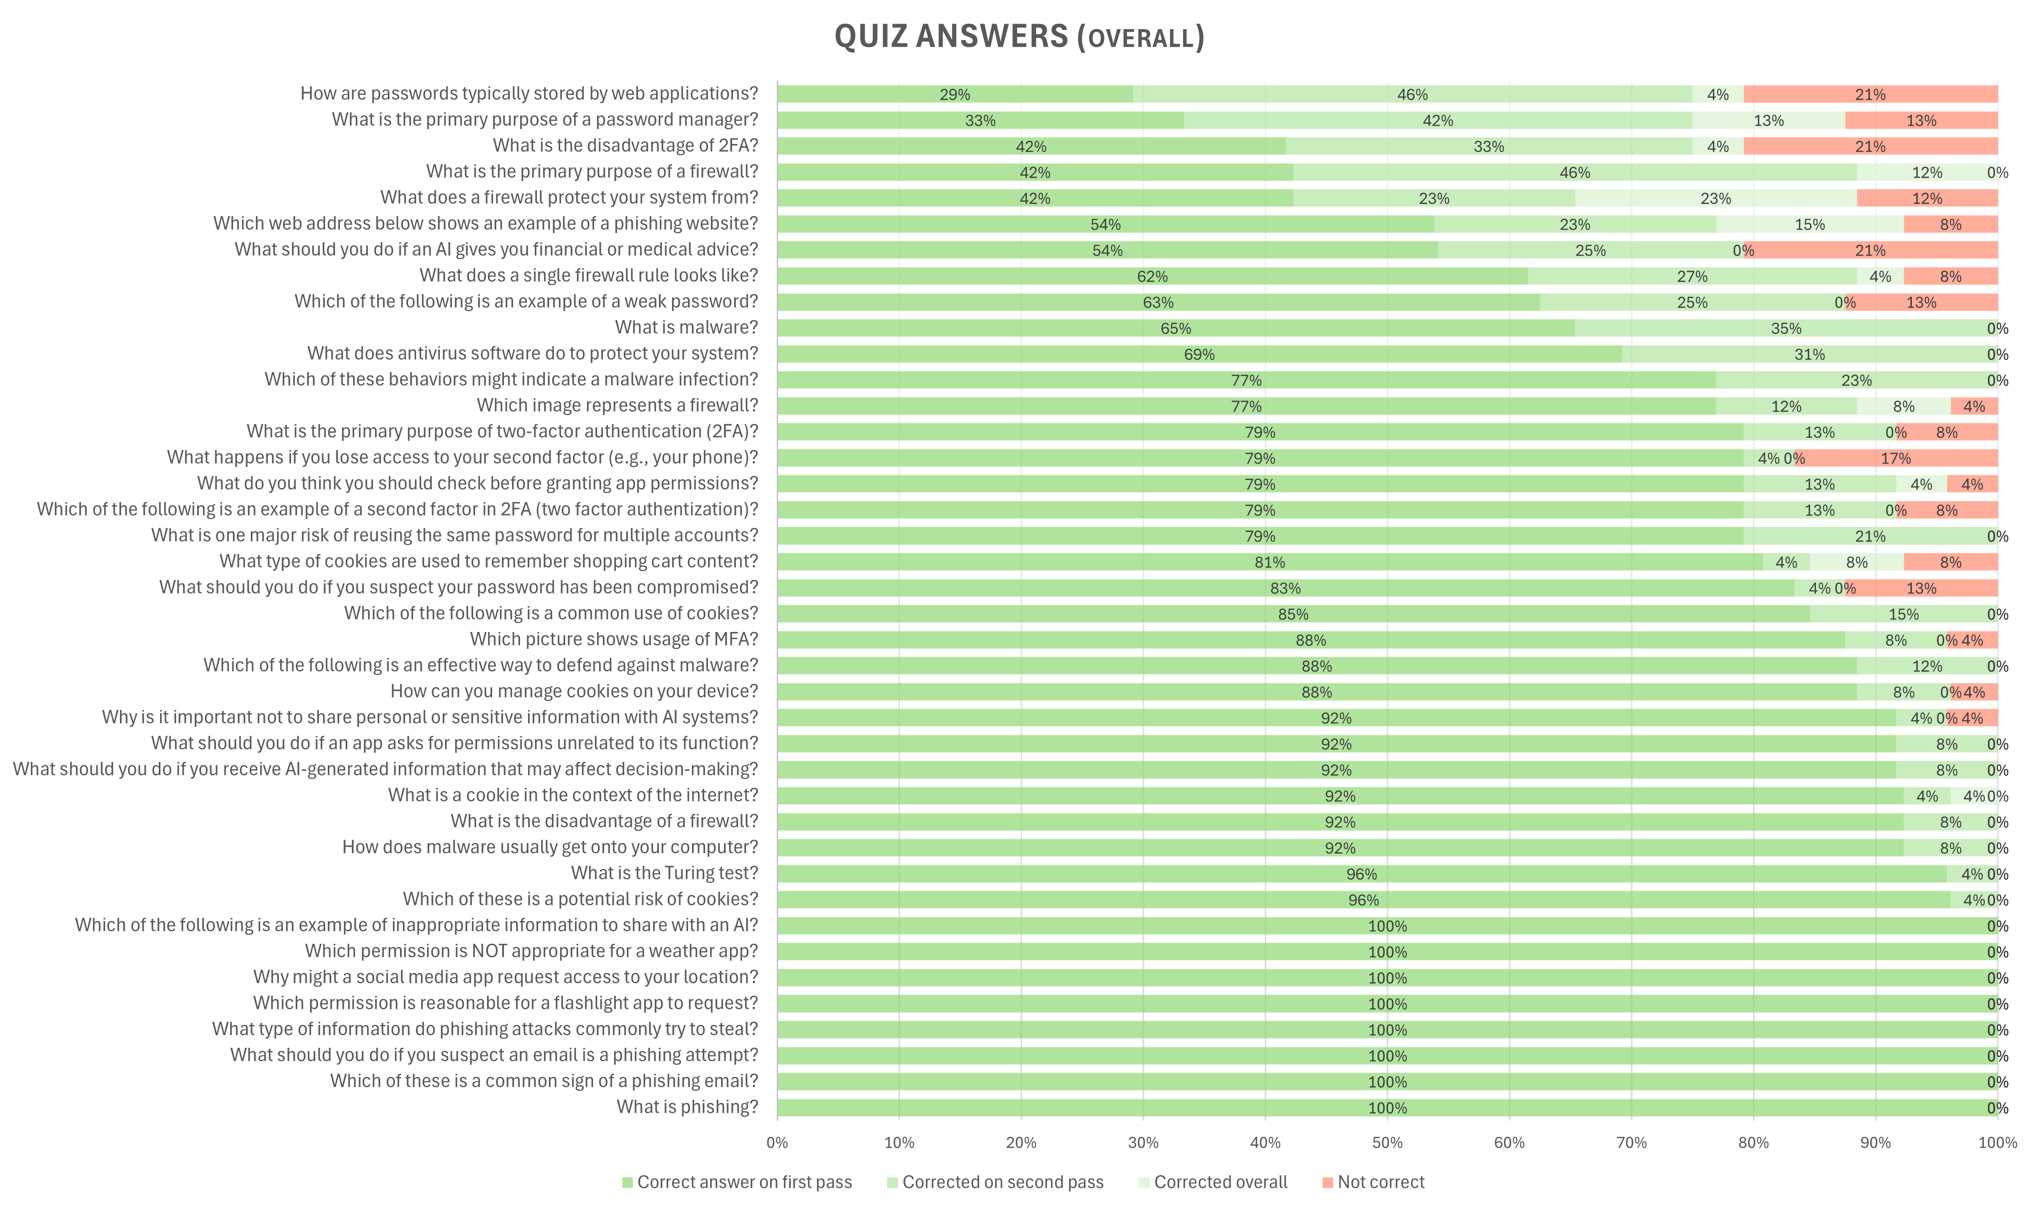

Testing & Results
Testing methodology
Data collection
Findings
Kids improved
from 79.1% to 95.3%
in the quiz.
5 Bugs
Discovered
(and fixed)
Data from the thesis

Slide 14


Conclusion & Future Work
Research security topics
Create educational game
Test the game
Cover more topics
Port to iOS
Translate to Slovak

Slide 15

Thank You
Image from deep.ai
Slide Chef presentation template

